Slide 1

ISM6225- Distributed Information Systems Project - Flask application development
Team Presenting:
Akhil Vayunandan Reddy
Gayathri Shanmugam
Sai Pavan Banala
Vinaya Nayak

Slide 2
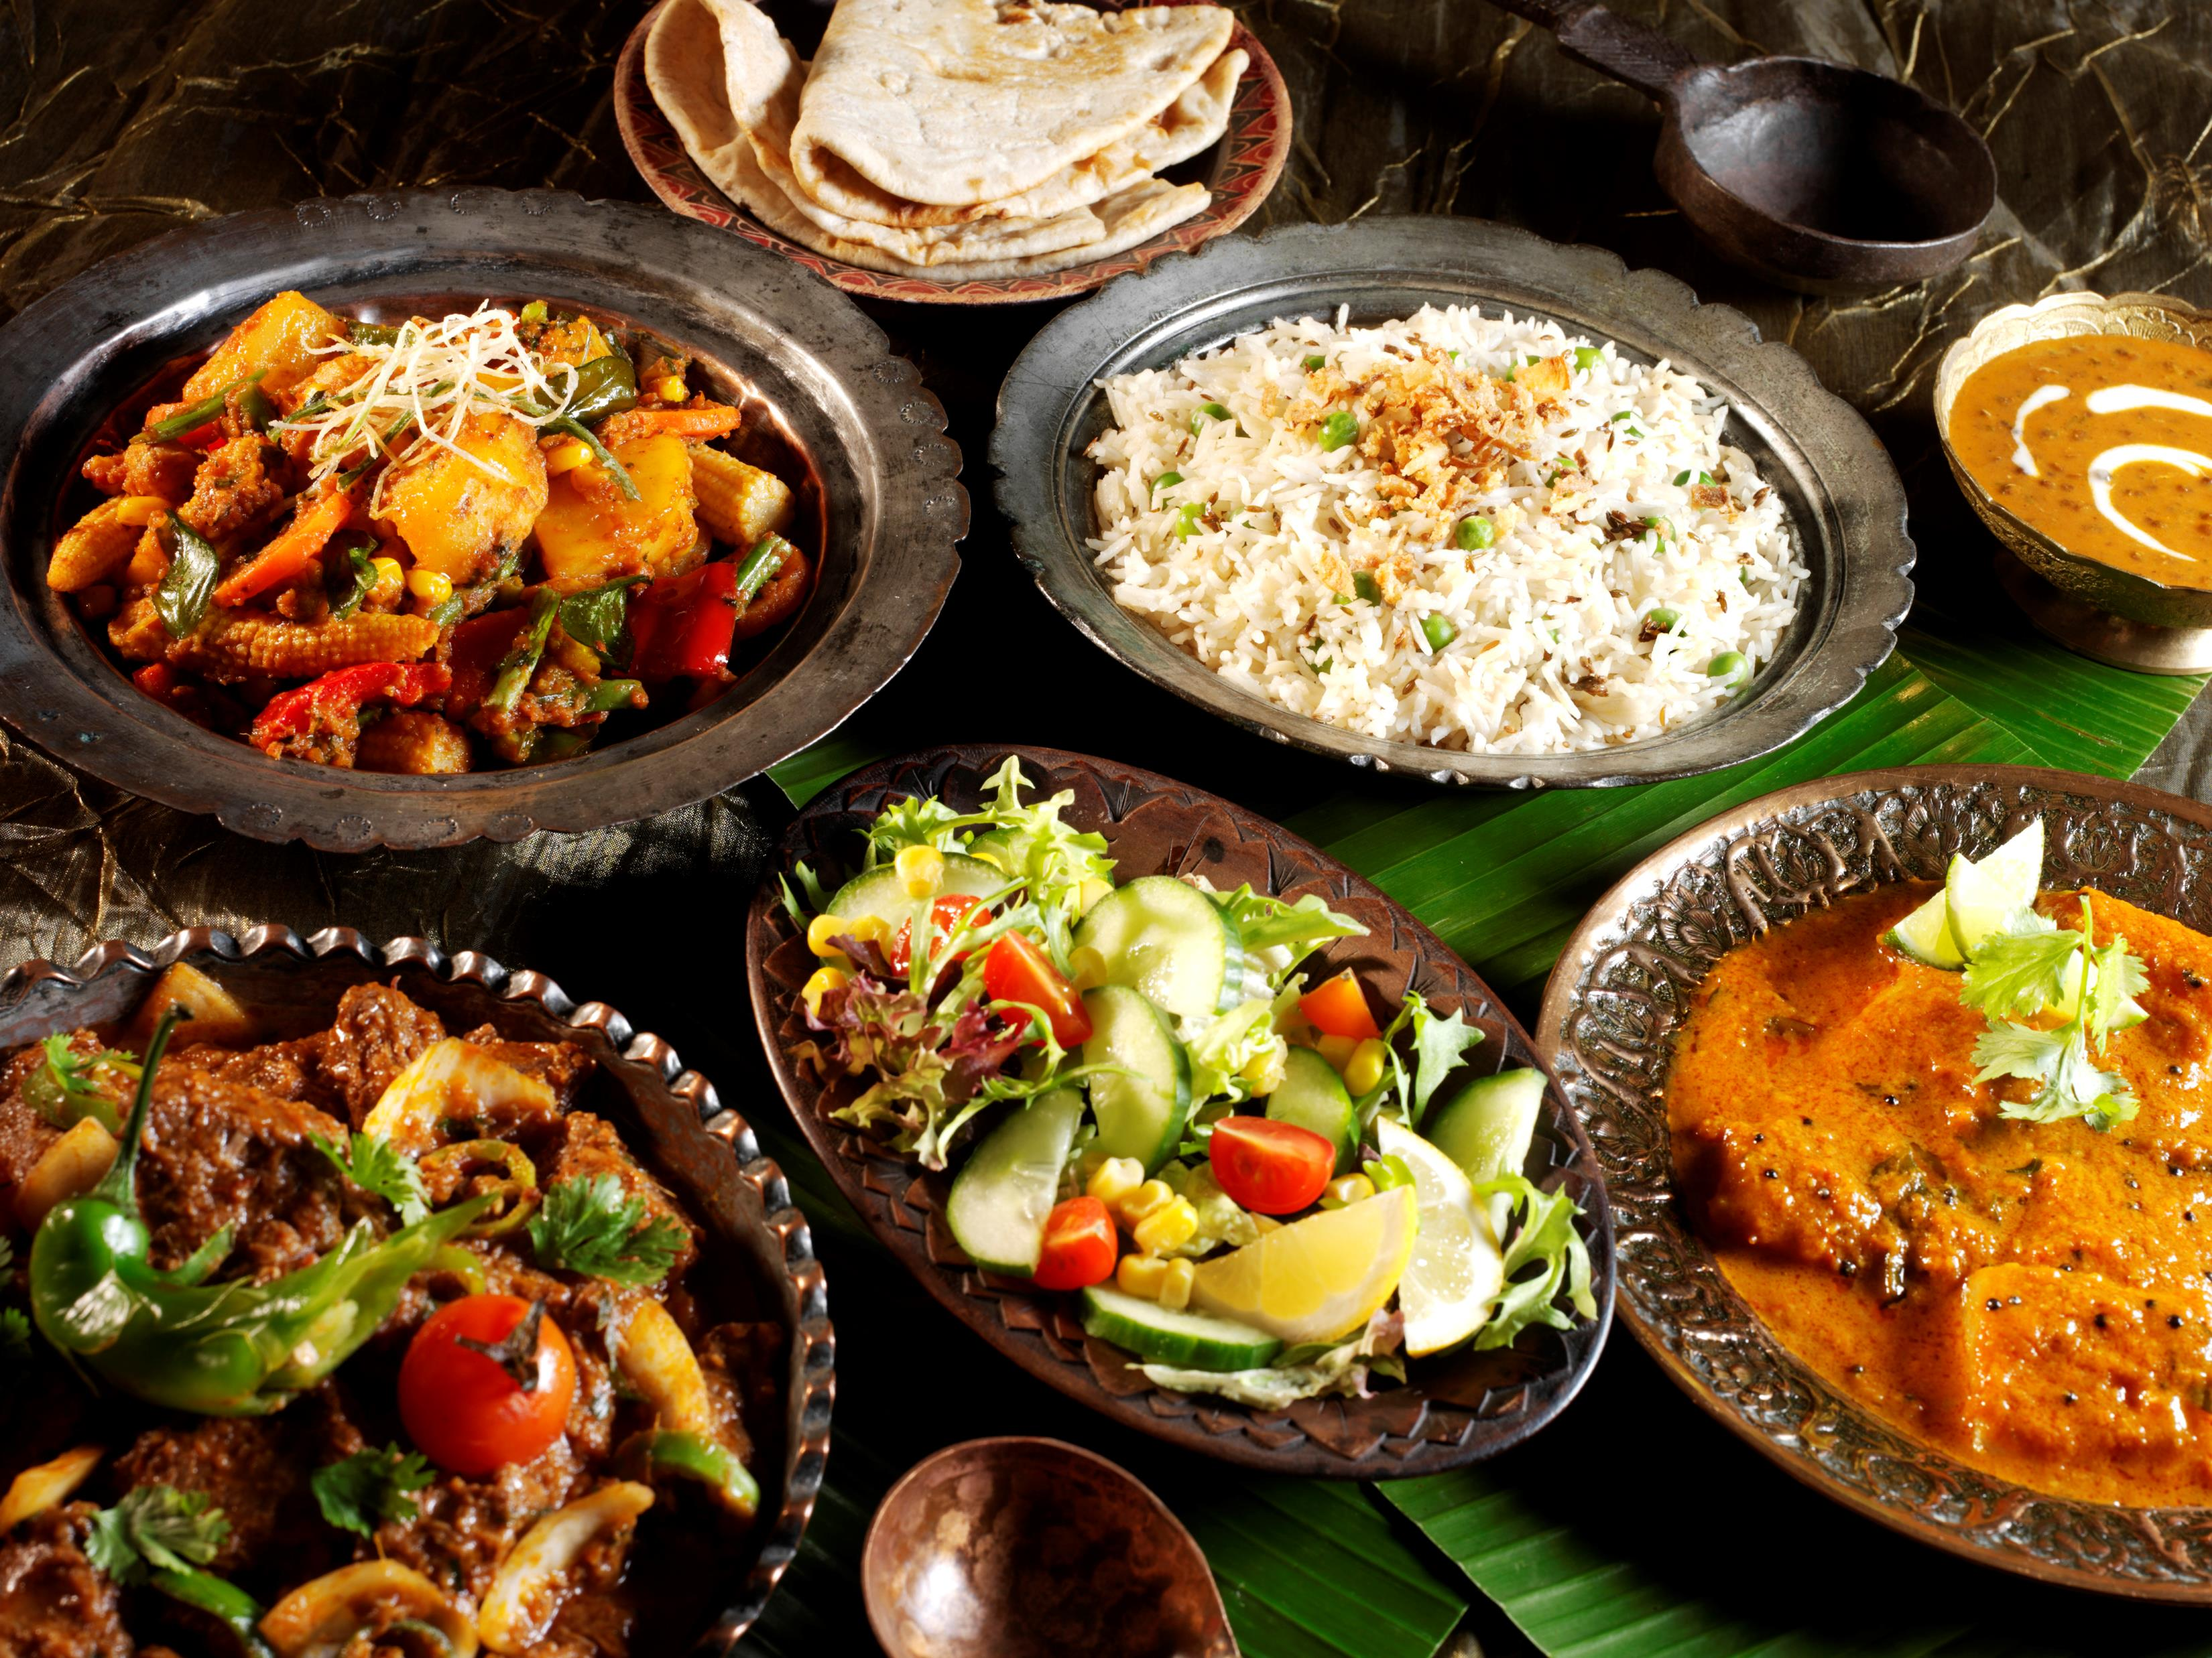

Table of content
Application Overview
Home page
Popular Item Page
Login page
Menu Page
Admin Interface
About us page
This Photo by Unknown Author is licensed under CC BY-SA

Slide 3

Application Overview
Foodgasm authentically is an application intended to create a user-friendly platform for users to easily place orders for pick up at the restaurant.
The technologies used are HTML, CSS, JavaScript, and Python Flask framework.
GitHub Link: https://github.com/Akhil8778/DIS_Group_Projects

Slide 4
Home Page
This code defines a webpage that displays information about the specials available at the restaurant.
On clicking the specials, users will be navigated to another page that describes the ingredients of the dish.
The webpage is structured using HTML and CSS, with dynamic content generated using Flask.

Slide 5
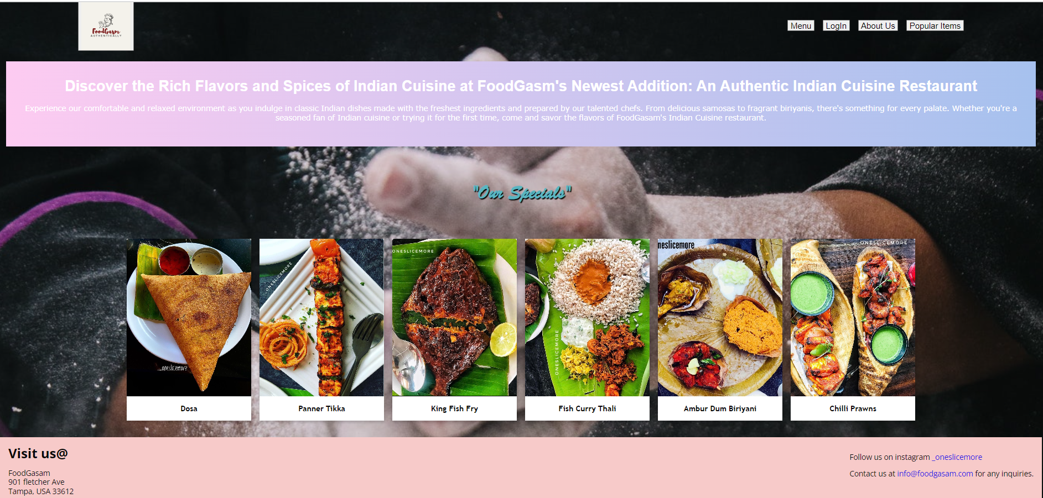
Home Page & Code

Slide 6
Popular Item Page
The popular Item page code shows the most sold item in the form of a pie chart.
The chart.js library is used in the development of this page content.

Slide 7
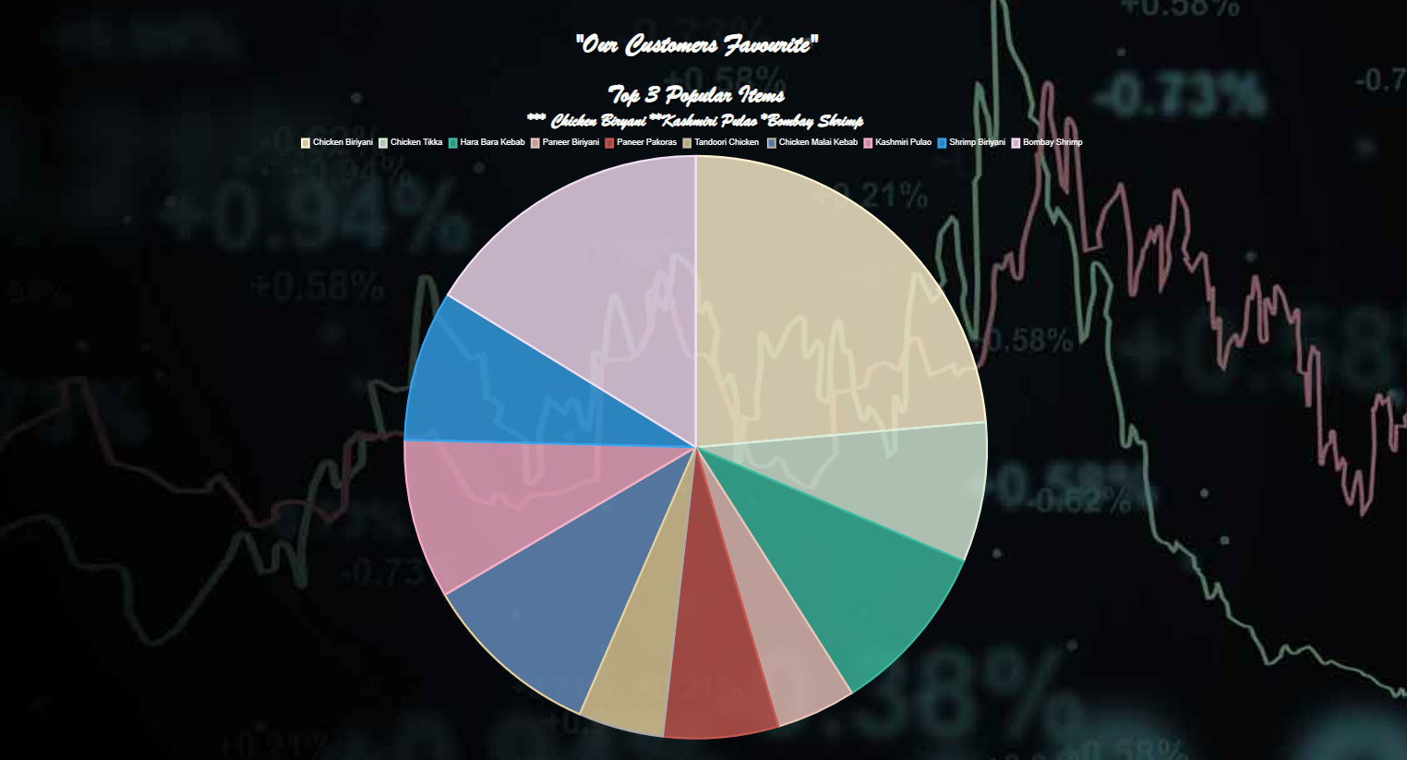
Popular Item Page

Slide 8
Login page
The login page of the website has a simple design to make it easy for users to access their accounts.
It also directs the New Customers to the Signup page for them to create an account with the restaurant.

Slide 9
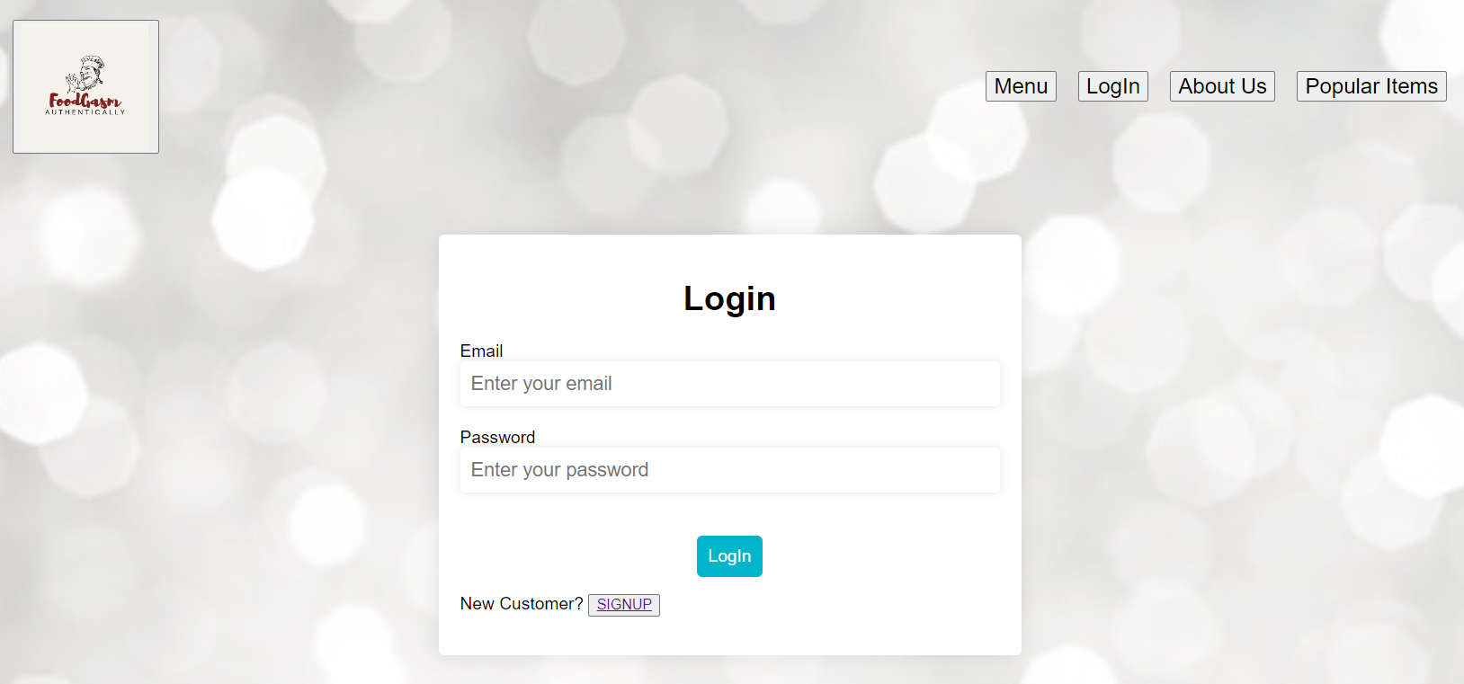
Login page

Slide 10
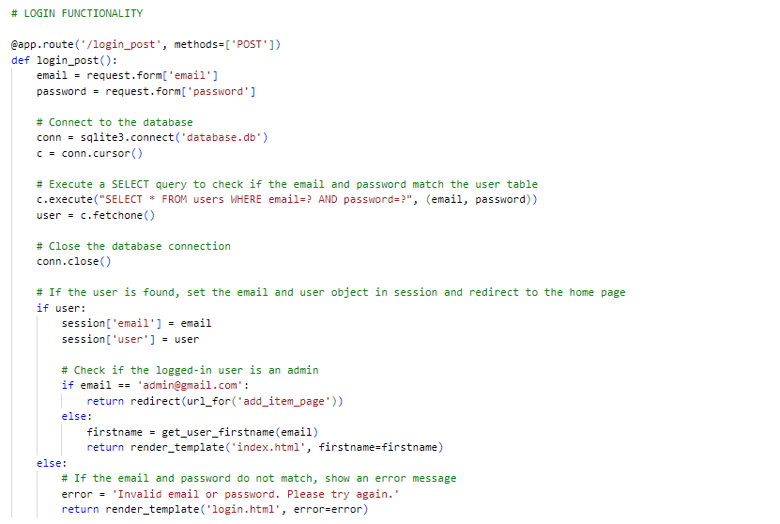
Login page Functionality

Slide 11
Signup page
The sign-up page of the website got a user-friendly design.
It has clear and concise instructions for filling out the required fields with validations.
It also has the link redirecting to log in if the user already has signed up.

Slide 12
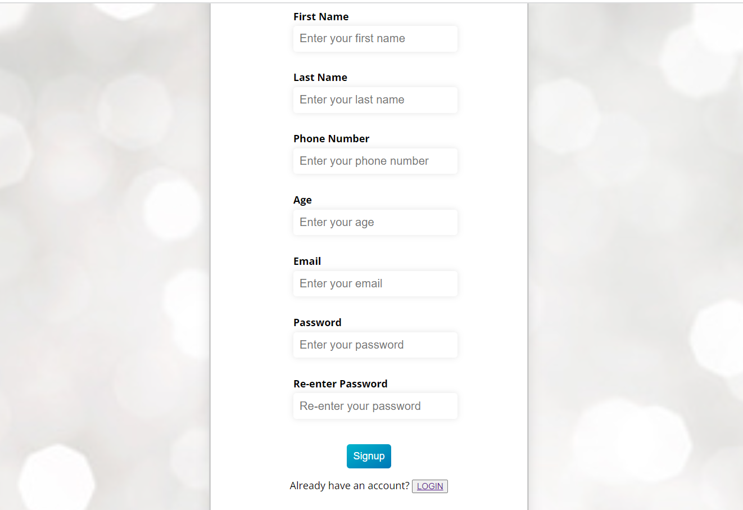
Signup page

Slide 13
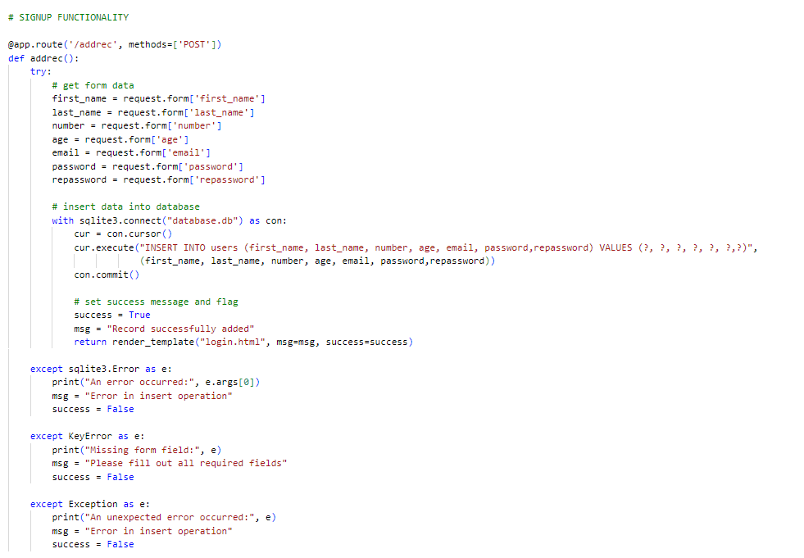
Sign-up Page Functionality

Slide 14
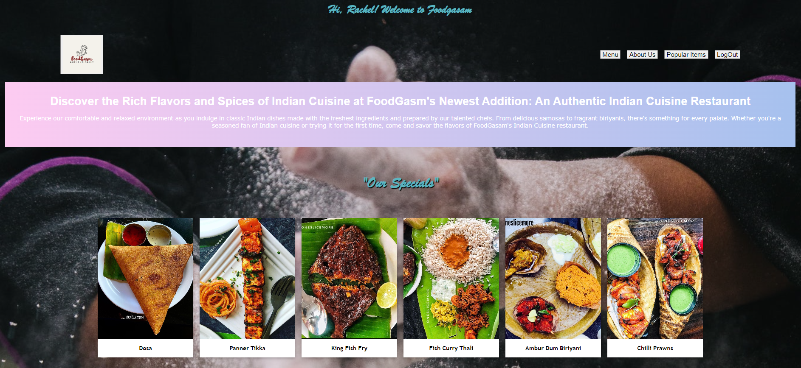
Home Page after Logging In

Slide 15
Menu Page
The menu page shows the list of menus available at the restaurant, which includes the item name, price, quantity, and add-to-cart option.
On adding items to the cart, it displays the total price of the order.
The user can place the order on this page.
Note: If the user has not logged in and tries to place an order, it will redirect to the login page.

Slide 16
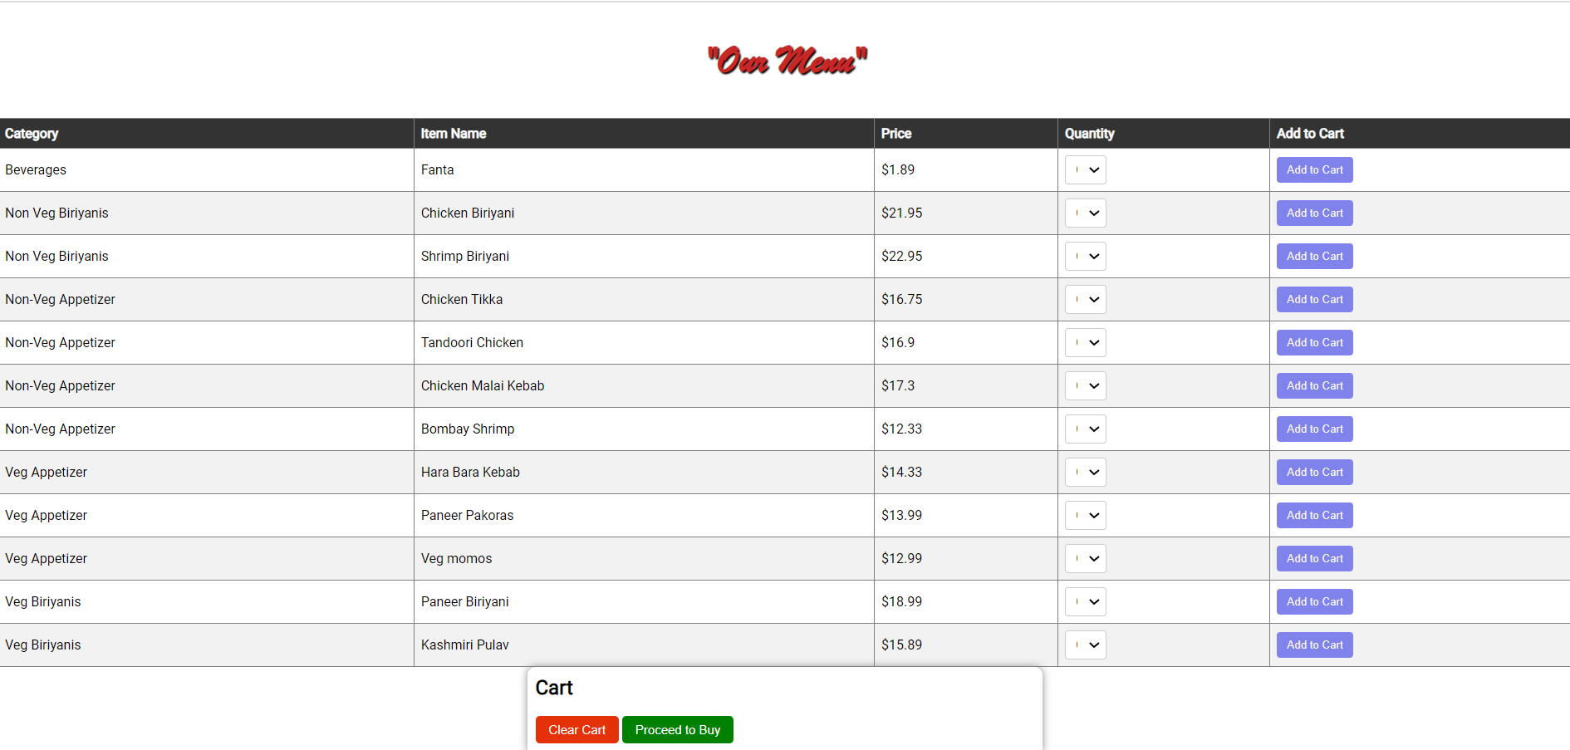
Menu Page

Slide 17
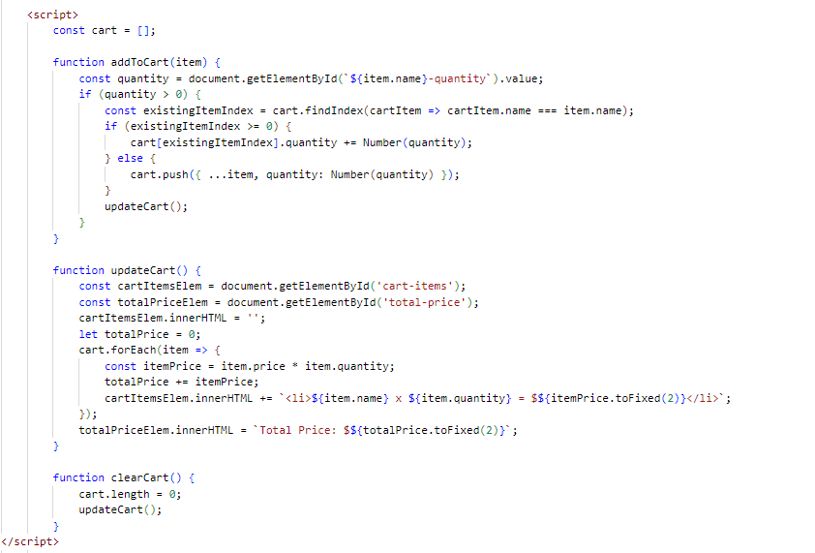
Menu Page & Code – Cart Management

Slide 18
Admin Interface
The admin interface is accessed through admin login credentials.
It is used in order to manage the menu of the restaurant like adding new items or updating the item.
Also, it lets the admin user see the list of signed-up customers’ details.

Slide 19
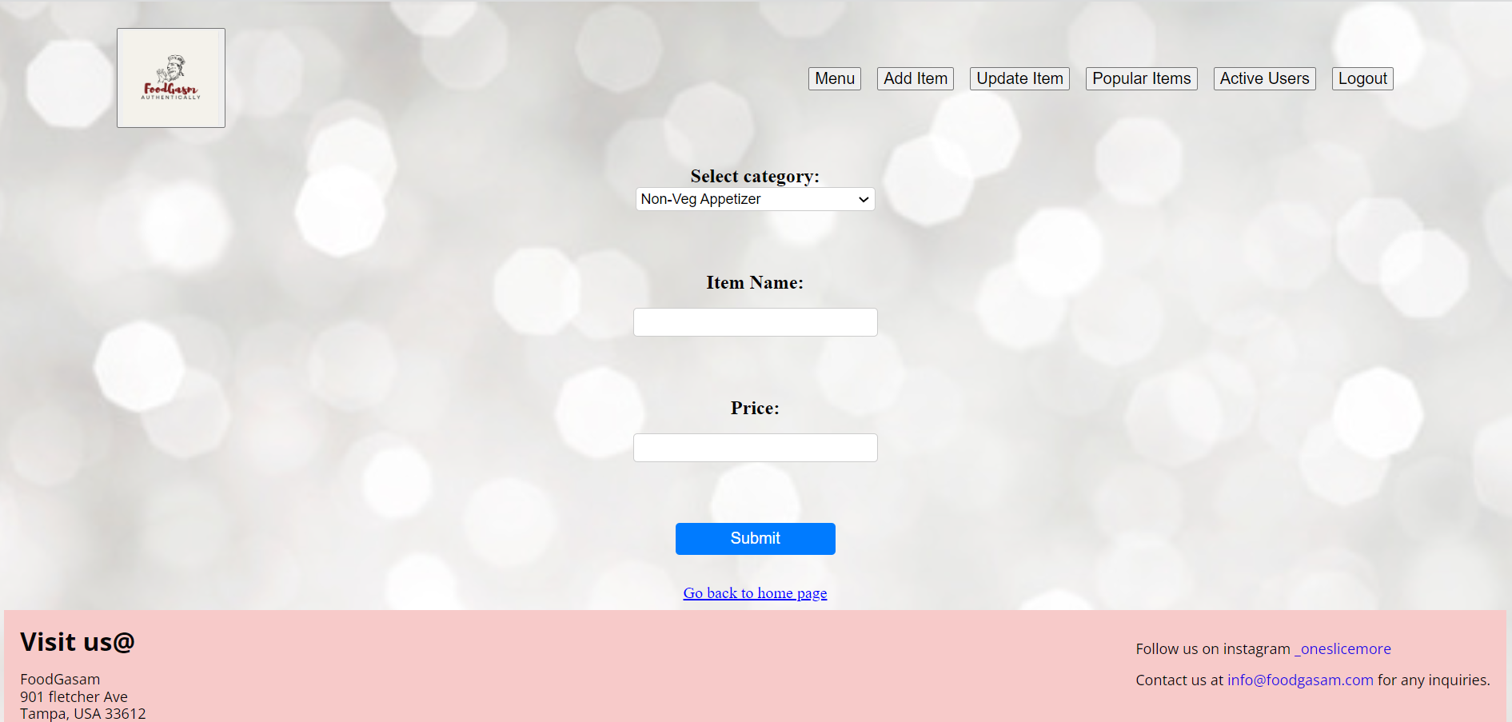
Admin Interface

Slide 20
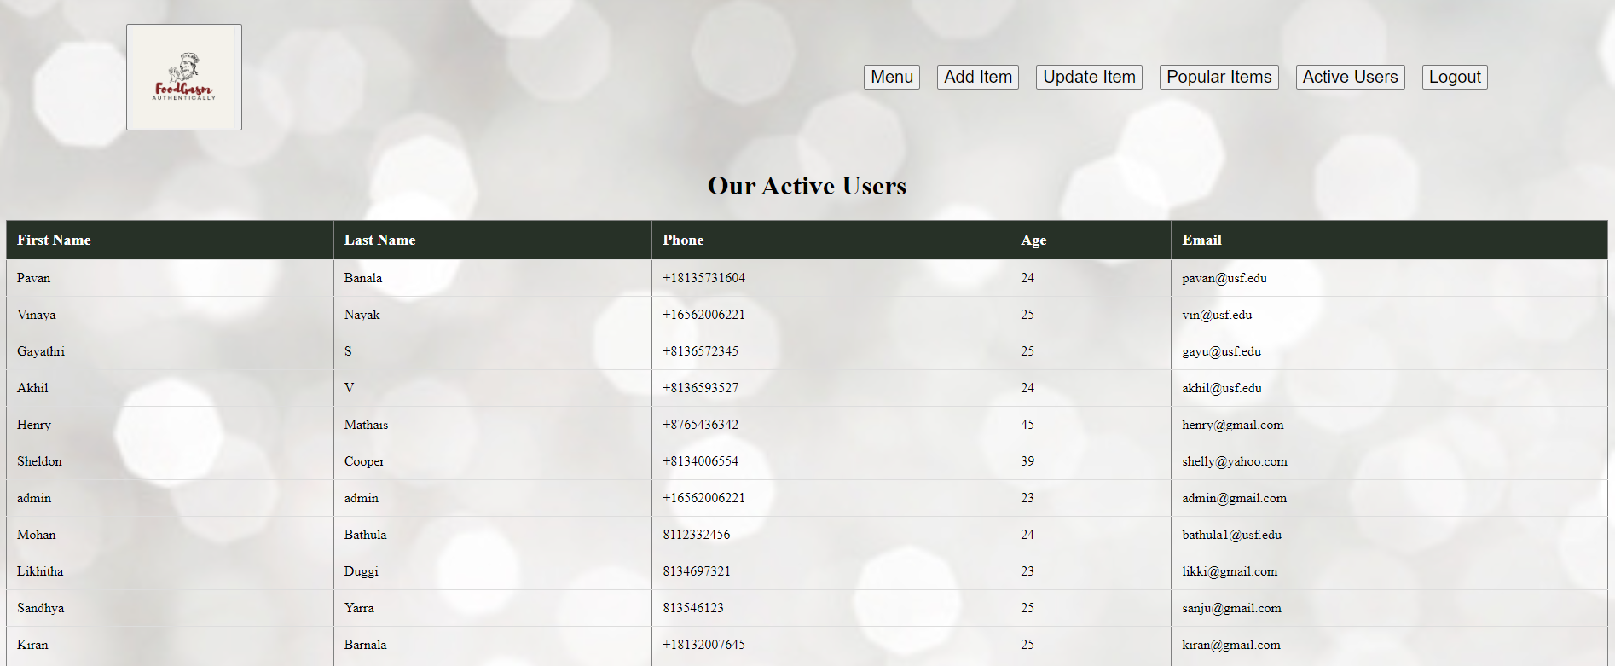
Admin Interface

Slide 21
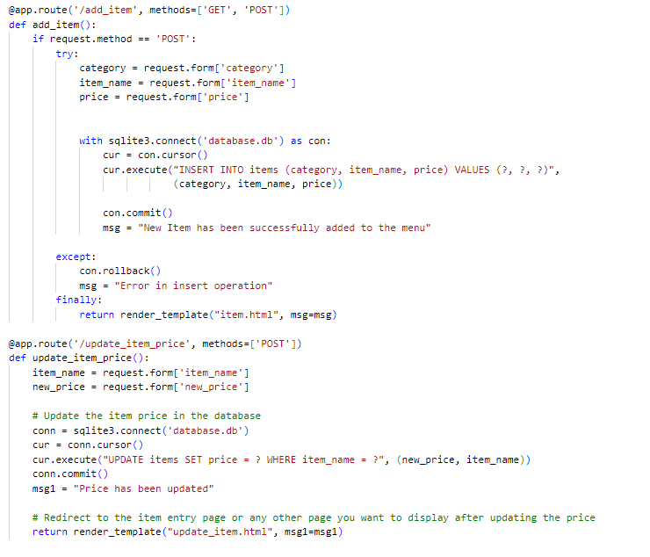
Admin Interface Code

Slide 22
About Us Page
The about us page of the website got a brief profile of the team members.
It highlights the team’s work accomplishments and links directing to their linked-in profile.

Slide 23
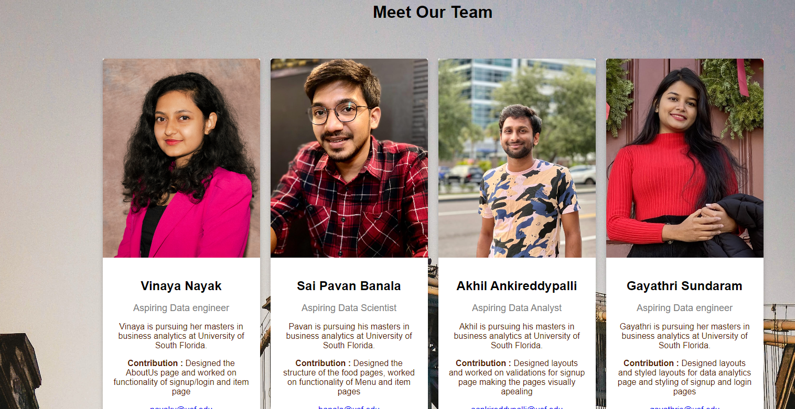

Slide 24
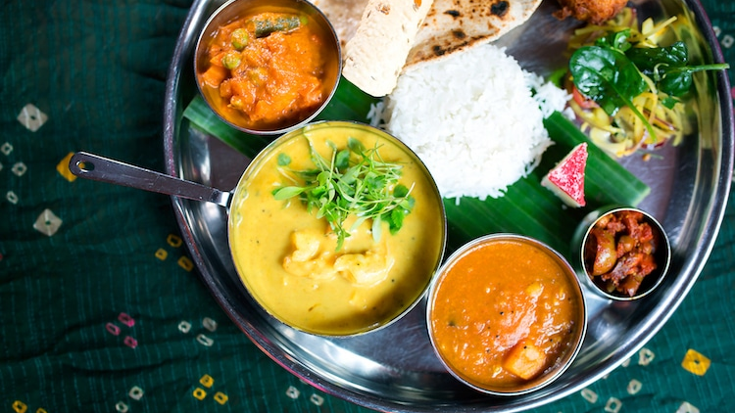
THANK YOU

